Slide 1
Employee Attrition ( Research Project ) By: Deepak Kumar

Slide 2
Contents
Case study and findings
What is attrition?
Reasons for attrition.
Steps to upload a dataset in SQL
Analyse the data using SQL

Slide 3
Case study
The project consists of one dataset
The dataset includes all the employee records along with the attrition details of the employees
The dataset consists of 36 columns and 1470 rows

Slide 4
What is Attrition?
The reduction in staff and employees in a company through normal means, such as retirement, resignation, or death.
This is considered natural in any business and industry.

Slide 5
Reasons for attrition
Unfair compensation and benefits
Lack of career growth opportunities
Change of career plan
Lack of appreciation and motivation
To pursue further study

Slide 6
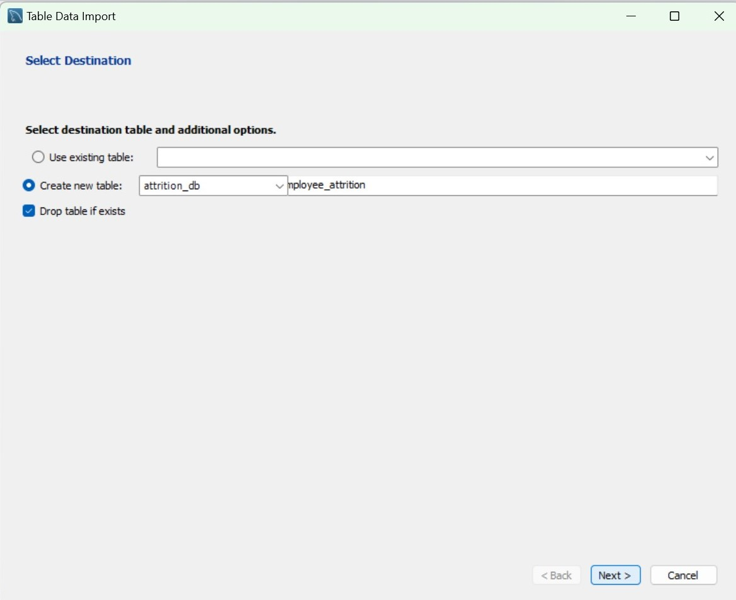
Steps to Upload a dataset in SQL
Step 1
Step 2
Step 4
Step 3
Step 5

Slide 7
Steps to Upload a dataset in SQL (Cont.)
Step 6
Step 7
Step 9
Step 8
Step 8
Step 10
Step 9

Slide 8
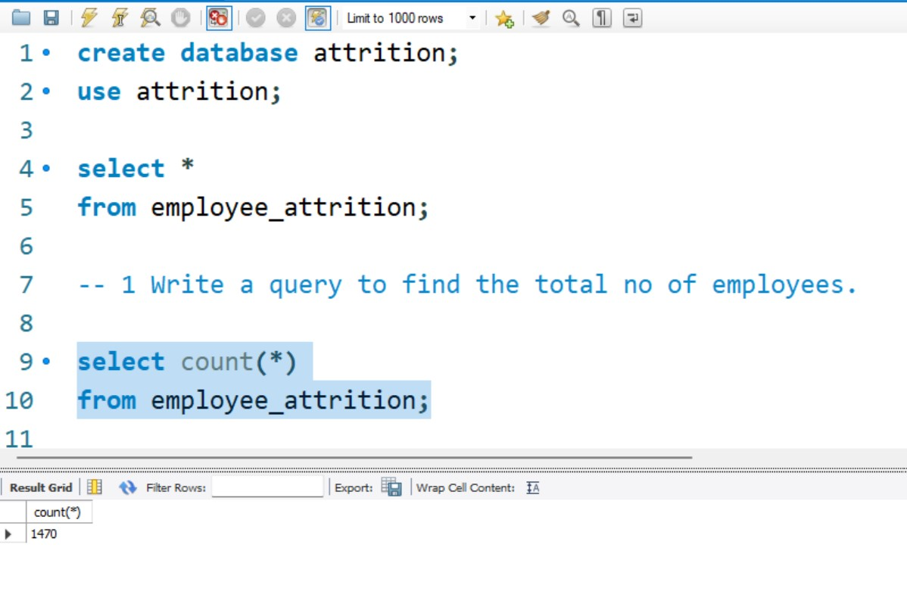
Data Analysis using SQL
SQL Query
(To find out the total no of employees)
Total no of employees - 1470

Slide 9
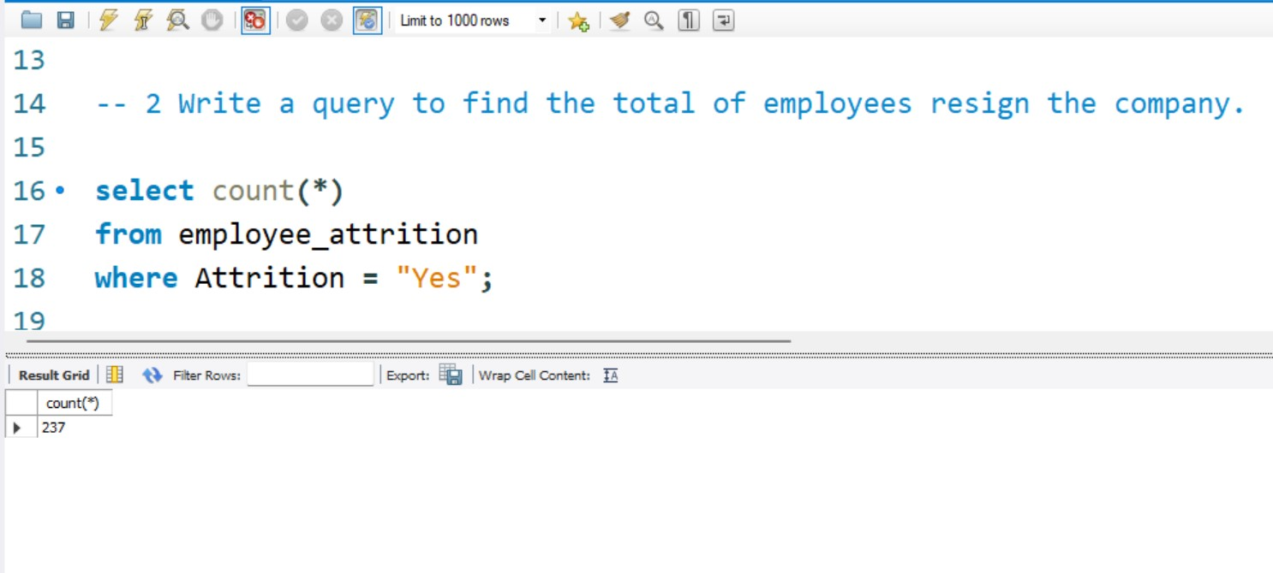
Data Analysis using SQL
SQL Query
(To find out the total no of attrition employees from the company)
No of attrition employees - 237

Slide 10
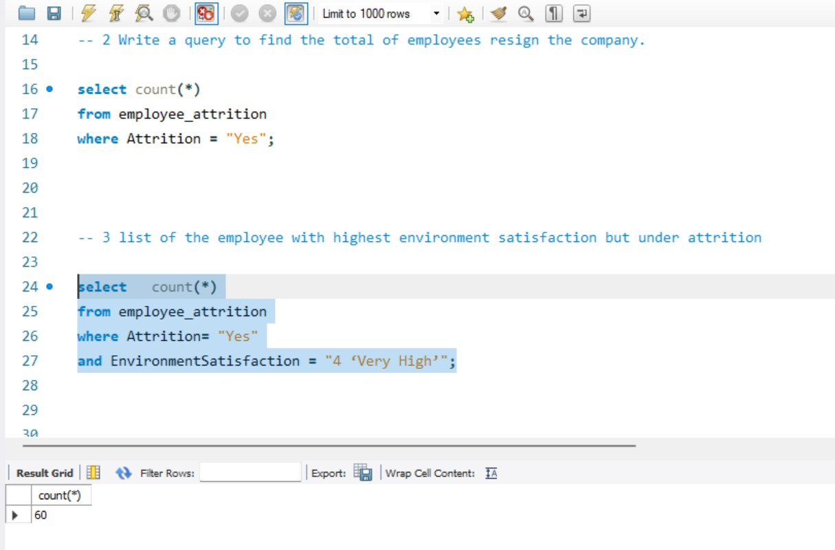
Data Analysis using SQL
SQL Query
( count of the employee with higher environment satisfaction but under attrition )
Total count - 60

Slide 11
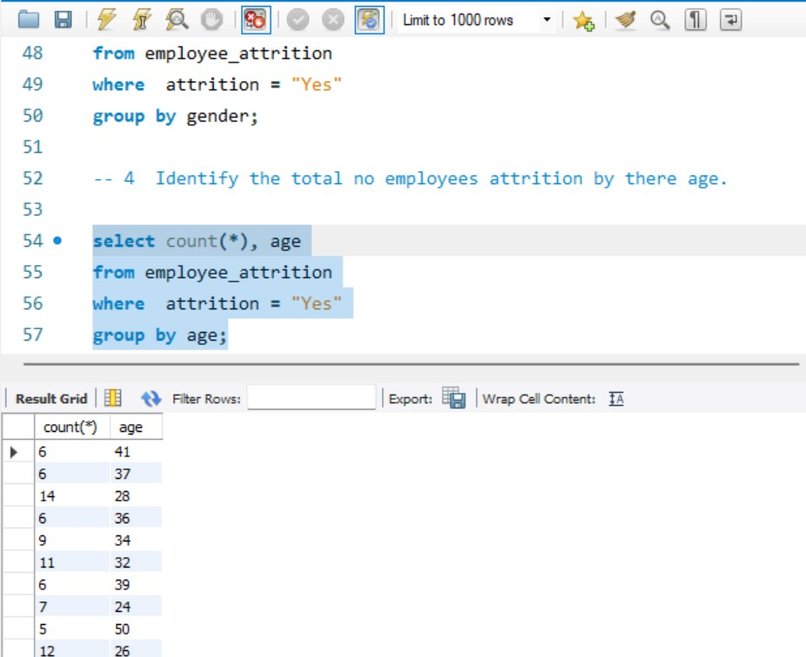
Data Analysis using SQL
SQL Query
( Identify the total no employees attrition by their age.)
At age 34 and 35 max number of employees left the company

Slide 12
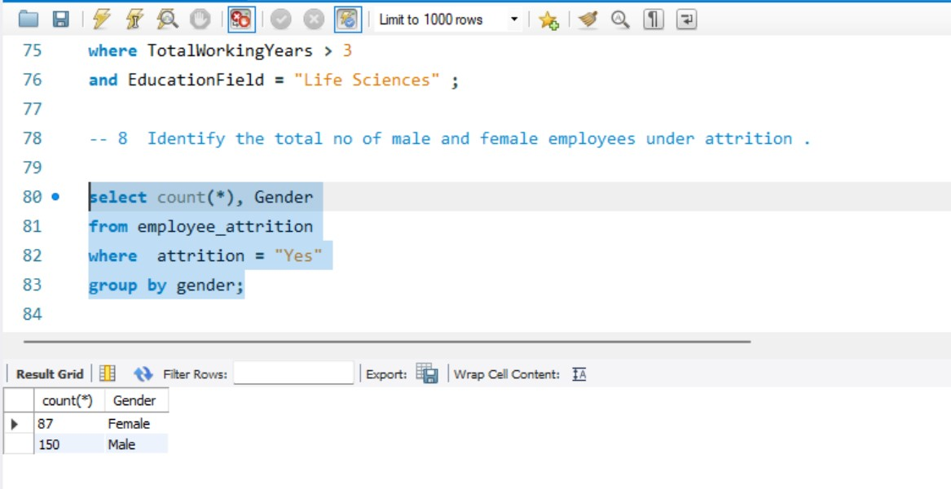
Data Analysis using SQL
SQL Query
( find the total no of employees attrition by gender )

Slide 13
Findings
Total no of employees – 1470
No of attrition employees - 237
Total count with higher environment satisfaction and under attrition – 60
At ages 34 and 35 max number of employees left the company
Male (60%) vs female (40%) attrition rate

Slide 14
Thank You

